Slide 1

LawLease: AI Chatbot for Law with Image Analysis
Project Guide
Prof. Aavani N
Group Members | Student ID
Sanchit Patil | 21107001
Swapnil Rathod | 21107064
Montu Suthar | 21107052
Ridvik Thakur | 21107056

Slide 2
Outline
Introduction
Literature Survey of the existing systems
Limitations of the existing systems
Problem statement
System Design
Technologies and methodologies
Implementation
Conclusion
References

Slide 3
Introduction
In today's rapidly evolving legal landscape, the integration of artificial intelligence (AI) technologies presents unprecedented opportunities to enhance the efficiency, accuracy, and accessibility of legal services.
Our project focuses on exploring the potential applications of AI in the field of law, particularly in legal decision-making processes and document analysis.
Through the development and implementation of AI-driven solutions, we aim to address key challenges faced by legal professionals, such as time-intensive legal research, contract analysis, and predictive analytics.

Slide 4
Scope and Necessity: The increasing complexity and volume of legal documents necessitate innovative solutions to enhance the efficiency and accuracy of legal processes. Traditional methods of manual document review and data analysis are time-consuming and prone to errors, highlighting the need for AI-driven tools to overcome these limitations.
Objectives:
To Develop AI-powered tools for legal research and document analysis to expedite the process of case preparation and contract review.
To Implement predictive analytics models to forecast legal outcomes and identify potential risks and opportunities for clients.

Slide 5
Literature Survey of the existing system
Author | Year | Title | Methods used | Merits | Demerits
Steven Harmon, Vikram Mahindhar | 2023 | [1]AI Advantage in Law | Natural Language Processing, Machine Learning | - Increased efficiency and cost-effectiveness in legal workflows. - Improved accuracy and precision | - Ethical considerations regarding bias in AI algorithms and client confidentiality.
Kevin D. Ashley | 2022 | [2]Artificial Intelligence and Legal Decision-Making | Machine Learning, Decision Support Systems | - Enhanced decision-making through AI assistance. | -Dependence on quality and relevance of input data.
Philipp Hacker, Niklas Kiermeyer | 2022 | [3]Legal Tech, Smart Contracts, and Blockchain | Blockchain Technology, Smart Contracts | Enhanced security and transparency in contracts. | Complexity and scalability issues in blockchain implementation.

Slide 6
Author | Year | Title | Methods used | Merits | Demerits
Brent Mittelstadt et al. | 2021 | [4]Machine Learning, Ethical Analysis | Natural Language Processing, Machine Learning | - Potential for improving outcomes and efficiency | - Concerns regarding user privacy and data security
Richard Tromans | 2018 | [5]Legal AI: A Guide for Lawyers | Machine Learning, Natural Language Processing | - Accelerated legal research and case analysis. | - Lack of standardized data and interoperability.

Slide 7
Limitations of existing systems
Lack of Emotional Intelligence: AI lawyers lack human empathy and emotional intelligence, which can be crucial in certain legal situations such as negotiations, mediations, and client interactions.
Complexity and Nuance: Despite advancements in natural language processing, AI lawyers may struggle to understand the subtle nuances, context, and ambiguity often present in legal documents and conversations.
Ethical and Moral Judgment: AI lawyers may face challenges in making ethical and moral judgments, as these often require subjective reasoning, cultural understanding, and context-specific considerations that may be beyond their programming.
Limited Creativity: While AI lawyers excel at processing and analyzing data, they may struggle with creative problem-solving and innovative legal strategies that require thinking outside the box.

Slide 8
Problem statement
High Workload: Real lawyers often face overwhelming workloads due to manual document review, research, and administrative tasks.
Limited Availability: Human lawyers have limited availability, making it difficult for clients to get immediate assistance or updates on their cases.
Costly Services: Legal services can be expensive, making them inaccessible to many individuals who need legal assistance.
Solution :
Efficient Document Review: LawLease can quickly review large volumes of documents, saving time and reducing the burden on human lawyers.
24/7 Availability: AI lawyers can provide round-the-clock assistance, allowing clients to get instant answers to their legal queries.
Cost-Effective Services: AI lawyers offer cost-effective solutions, making legal services more accessible to a broader range of individuals.

Slide 9
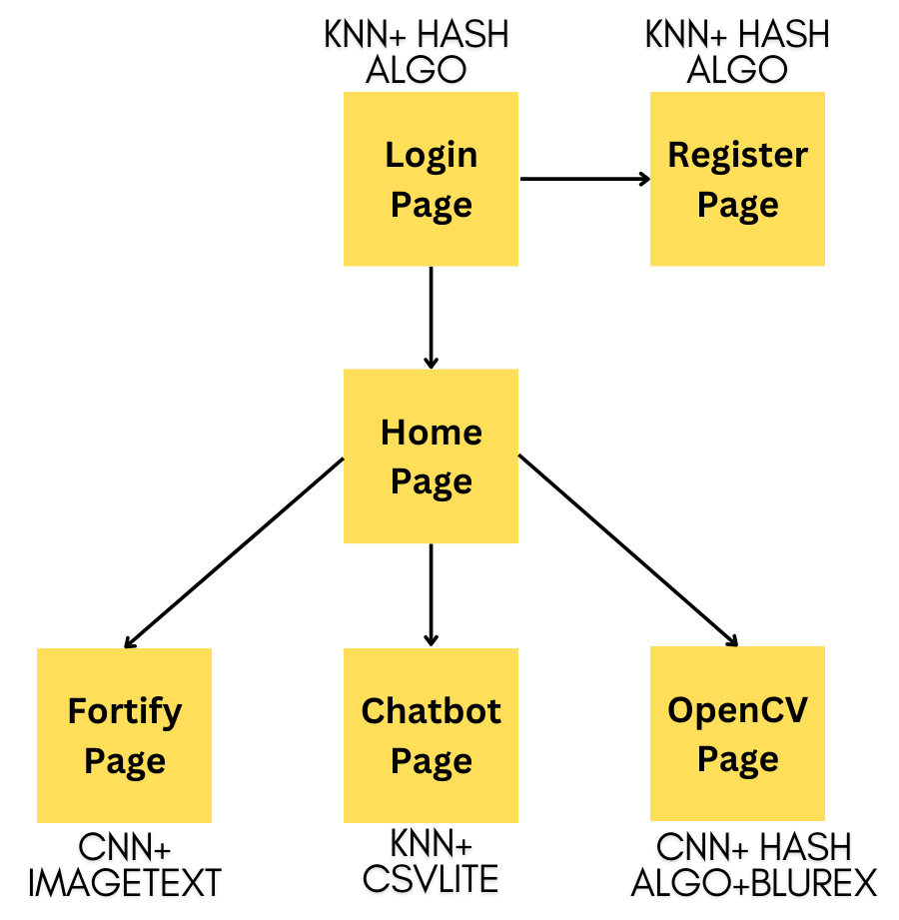
System Design

Slide 10
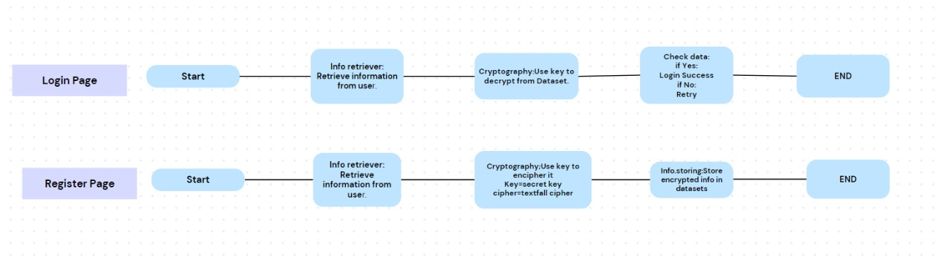

Slide 11
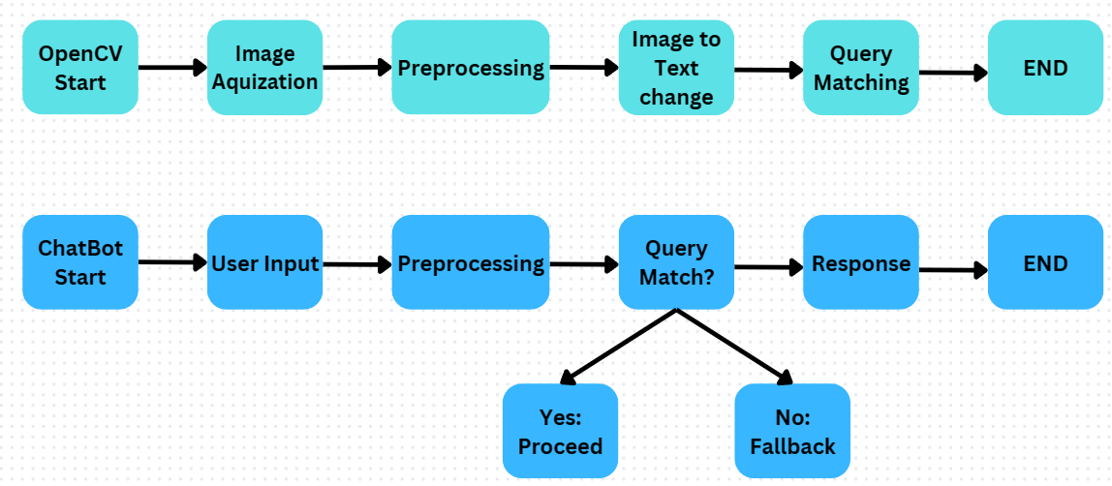

Slide 12
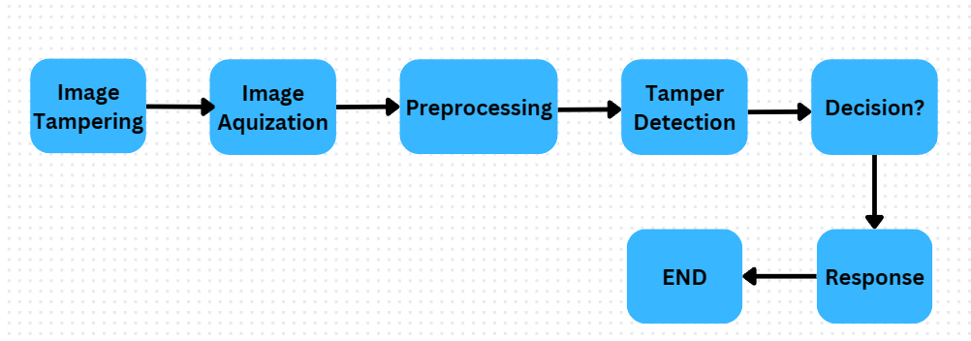

Slide 13
Technologies and methodologies
Dataset:
1) Set.csv (1500 rows, 5 columns)
2)Explain.csv (1000 rows, 4 columns)
Algorithms:
1) CNN (OpenCV, Fortify)
2)KNN (login, Register, Chatbot)
Software Used:
1) VS Code 5.11.3 5) Pandas 7.2.1
2) Python 4.2.1 6) HashLib 4.4
3) HTML + CSS 3.04.02 7) Javascript 3.01.2.4
4) Flask 2.11

Slide 14
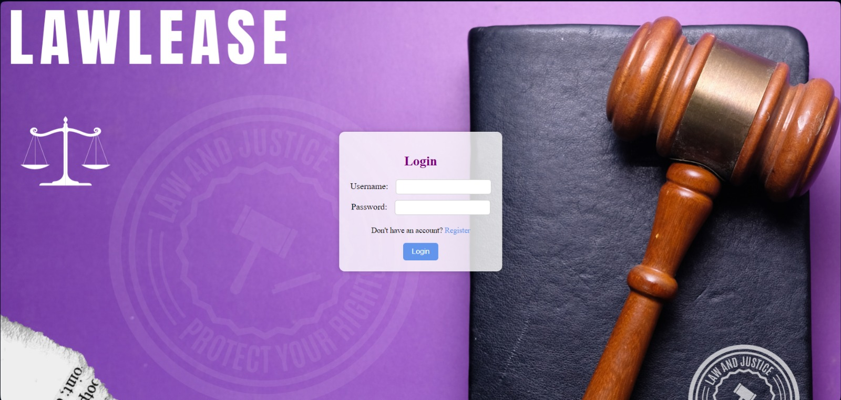
Implementation
Login page provides user as a starting page. If user’s account is present, user can proceed; else, he can register.

Slide 15
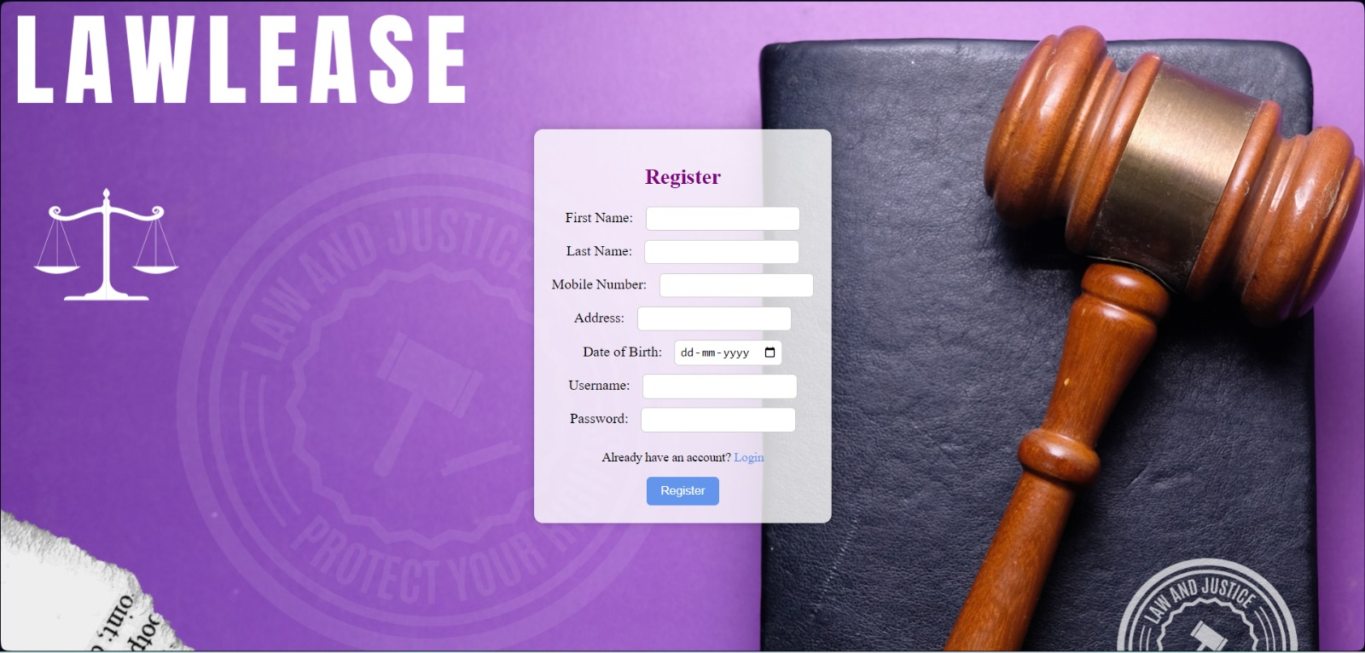
Register page provides user to register his/her account. The information will be encrypted to make it secure.

Slide 16
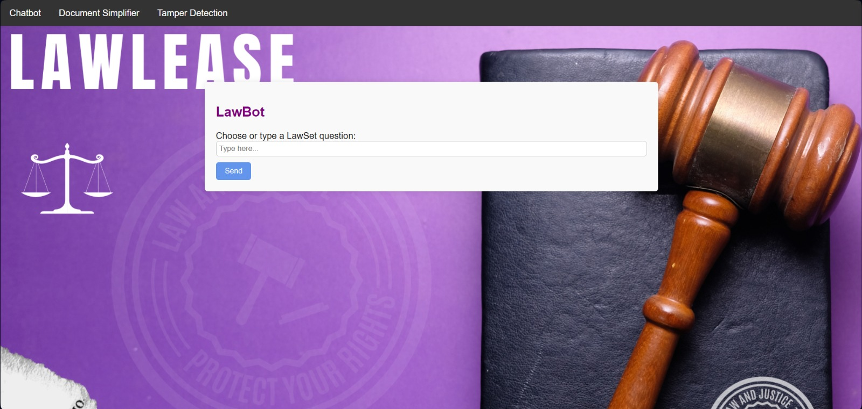
LawBot page provides user to solve user’s query in an simple way.

Slide 17
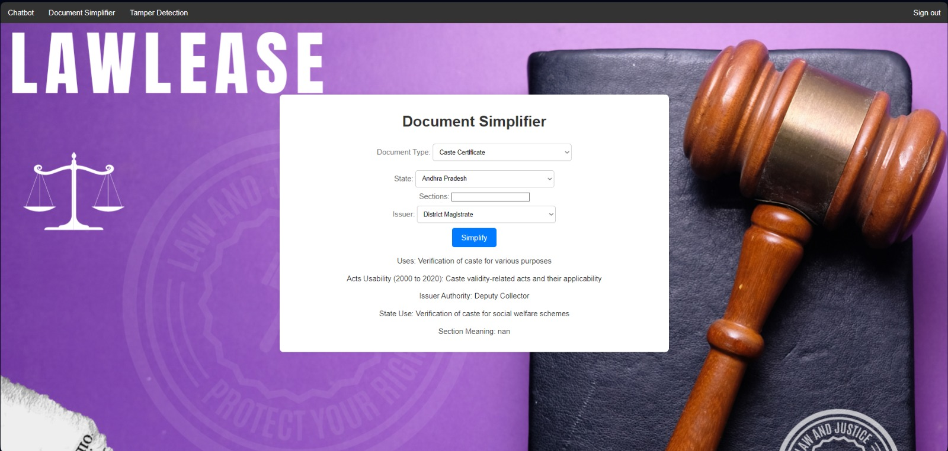
Document Simplifier page provides user to insert a document information and simplify it in easier way.

Slide 18
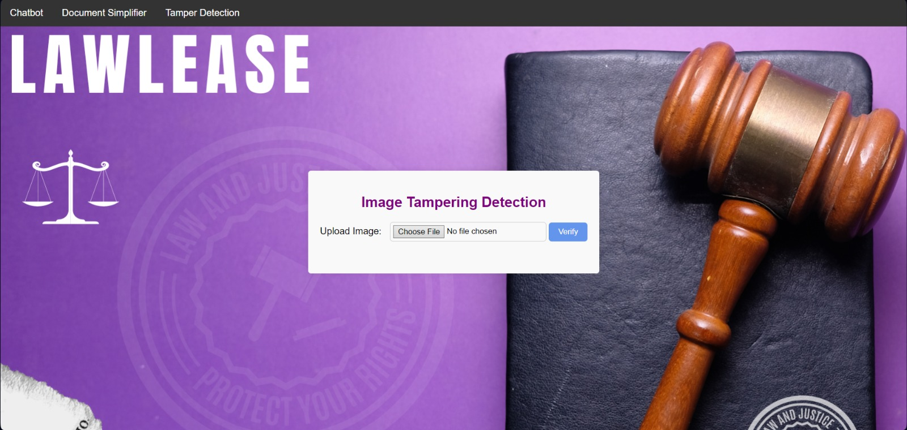
Tamper Detection page provides user to verify authenticity of a document.

Slide 19
Conclusion
Transformative Potential: It represent a transformative advancement in the legal industry, offering unparalleled efficiency, accuracy, and accessibility.
Streamlined Processes: By automating routine tasks and leveraging advanced technologies such as natural language processing and machine learning, AI lawyers streamline legal processes and optimize resource allocation.
Enhanced Decision Support: They provide invaluable decision support to legal professionals, offering data-driven insights, predictive analysis, and strategic guidance.
Cost Savings: Utilizing them results in significant cost savings for law firms and clients, reducing operational expenses and maximizing productivity.

Slide 20
References
[1] “The AI Advantage in Law”,Steven Harmon, Vikram Mahindhar,2023,
[2] “Artificial Intelligence and Legal Decision Making”, Pearson Education,Pearson Publications,Kevin D Ashley, A. B., & Williams, C. D., Year: 2020
[3] “Legal Tech, Smart Contracts, and Blockchain”, Philipp Hacker, Niklas Kiermeyer, Volume(Issue): 42(3),
123-135, DOI: 10.1080/12345678.2020
[4] “Machine Learning, Ethical Analysis”, Brent Mittelstadt et al, , Brent Mittelstadt et al, C. D., Year: 2021

Slide 21
Thank You...!!

